Slide 1
IBM MAINFRAMES
Job control Language(JCL) - 02

Slide 2
JCL utilities
JCL UTILITIES are pre-written program supplied by IBM
Using this utilities we can do many operations by submitting a JOB
This helps in removing manual interruption which may cause during execution jobs

Slide 3
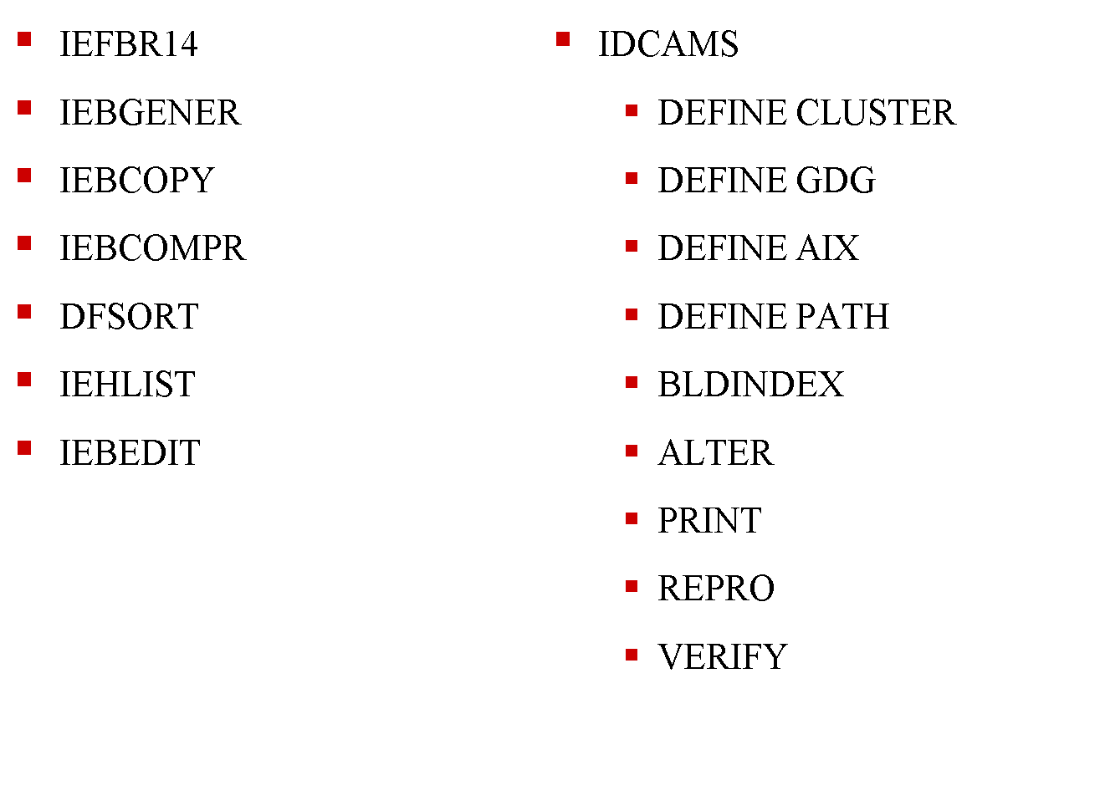
List Of Utilities

Slide 4
IEFBR14
JCL to allocate the new data set and delete a data set
//FSS245CL JOB (123),'POLSANI‘,NOTIFY=&SYSUID
//STEP001 EXEC PGM=IEFBR14
//SYSPRINT DD SYSOUT=*
//SYSOUT DD SYSOUT=*
//SYSDUMP DD SYSOUT=*
//DD1 DD DSN=FSS245.POLSANI.EMPFILE,
// DISP=(NEW,CATLG,DELETE),
// SPACE=(TRK,(1,1),RLSE),
// UNIT=SYSDA,
// DCB=(DSORG=PS,RECFM=FB,LRECL=23,BLKSIZE=230)
//

Slide 5
IEFBR14
//FSS245CL JOB (123),'POLSANI‘,NOTIFY=&SYSUID
//STEP10 EXEC PGM=IEFBR14
//SYSPRINT DD SYSOUT=*
//SYSOUT DD SYSOUT=*
//SYSDUMP DD SYSOUT=*
//DD1 DD DSN=FSS245.POLSANI.COBPGMS,
// DISP=(NEW,CATLG,DELETE),
// SPACE=(TRK,(10,10,10),RLSE),
// UNIT=SYSDA,
// DCB=(DSORG=PO,RECFM=FB,LRECL=80,BLKSIZE=800)
//

Slide 6
IEFBR14 TO DELETE A DATASET
//FSS245CL JOB (123),'POLSANI‘, NOTIFY=&SYSUID
//STEP20 EXEC PGM=IEFBR14
//SYSPRINT DD SYSOUT=*
//SYSOUT DD SYSOUT=*
//SYSDUMP DD SYSOUT=*
//DD1 DD DSN=FSS245.POLSANI.COBPGMS,
// DISP=(OLD,DELETE,DELETE)
//

Slide 7
IEBGENER
To copy PS data set to PS data set.
//FSS245SO JOB (123),'POLSANI',NOTIFY=&SYSUID
//STEP10 EXEC PGM=IEBGENER
//SYSPRINT DD SYSOUT=*
//SYSOUT DD SYSOUT=*
//SYSDUMP DD SYSOUT=*
//SYSUT1 DD DSN=FSS245.POLSANI.EMPFILE,DISP=SHR
//SYSUT2 DD DSN=FSS245.POLSANI.EMPFILE.BACKUP,
// DISP=(NEW,CATLG,DELETE),
// SPACE=(TRK,(1,1),RLSE),
// UNIT=SYSDA,
// DCB=(DSORG=PS,RECFM=FB,LRECL=23,BLKSIZE=230)
//SYSIN DD DUMMY
//

Slide 8
IEBCOPY
To copy PDS data set to PDS data set.
//FSS245CL JOB (123),'POLSANI‘, NOTIFY=&SYSUID,REGION=6M
//STEP10 EXEC PGM=IEBCOPY
//SYSPRINT DD SYSOUT=*
//SYSOUT DD SYSOUT=*
//SYSDUMP DD SYSOUT=*
//SYSUT1 DD DSN=FSS245.POLSANI.COBOL,DISP=SHR
//SYSUT2 DD DSN=FSS245.POLSANI.COBOL.BACKUP,
// DISP=(NEW,CATLG,DELETE),
// SPACE=(TRK,(10,10,10),RLSE),
// UNIT=SYSDA,
// DCB=(DSORG=PS,RECFM=FB,LRECL=80,BLKSIZE=800)
//SYSIN DD *
COPY INDD=SYSUT1,OUTDD=SYSUT2
//

Slide 9
IEBCOPY
To copy PDS data set to PDS data set.
//FSS245CL JOB (123),'POLSANI‘, NOTIFY=&SYSUID,REGION=6M
//STEP10 EXEC PGM=IEBCOPY
//SYSPRINT DD SYSOUT=*
//SYSOUT DD SYSOUT=*
//SYSDUMP DD SYSOUT=*
//SYSUT1 DD DSN=FSS245.POLSANI.COBOL,DISP=SHR
//SYSIN DD *
COPY INDD=SYSUT1,OUTDD=SYSUT1
//
Used to compress the data set to regain the space

Slide 10
IEBCOPY
To selectively copy PDS members to the another PDS.
//FSS245CL JOB (123),'POLSANI‘, NOTIFY=&SYSUID,REGION=6M
//STEP10 EXEC PGM=IEBCOPY
//SYSPRINT DD SYSOUT=*
//SYSOUT DD SYSOUT=*
//SYSDUMP DD SYSOUT=*
//SYSUT1 DD DSN=FSS245.POLSANI.COBOL,DISP=SHR
//SYSUT2 DD DSN=FSS245.POLSANI.COBOL.BACKUP,
// DISP=(NEW,CATLG,DELETE),
// SPACE=(TRK,(10,10,10),RLSE),
// UNIT=SYSDA,
// DCB=(DSORG=PS,RECFM=FB,LRECL=80,BLKSIZE=800)
//SYSIN DD *
COPY INDD=SYSUT1,OUTDD=SYSUT2
SELECT MEMBER=PARMPGM,PARMPGM$
EXCLUDE MEMBER=PARMPGM,PARMPGM$
//

Slide 11
IEBCOMPR
To compare Data sets
//FSS245CL JOB (123),'POLSANI‘,NOTIFY=&SYSUID
//STEP10 EXEC PGM=IEBCOMPR
//SYSPRINT DD SYSOUT=*
//SYSOUT DD SYSOUT=*
//SYSDUMP DD SYSOUT=*
//SYSUT1 DD DSN=FSS245.POLSANI.COBOL,DISP=SHR
//SYSUT2 DD DSN=FSS245.POLSANI.COBOL.BACKUP,DISP=SHR
//SYSIN DD *
COMPARE TYPORG=PO / PS
//

Slide 12
SORT
Internal sort and External Sort

Slide 13
COBOL SORT
The COBOL SORT statement is used in the PROCEDURE DIVISION to place records from an input file in a temporary work file
where their order will be rearranged. This work file is referred to as the sort work file.
Once rearranged, the records can be placed back in the original input file, placed in a separate output file

Slide 14
DATA DIVISION entries
SD SORT-FILE.
01 SORT-RECORD.
02 PIC X(20).
02 SORT-KEY PIC X(5).
02 PIC X(30).
02 SR-UNITS PIC 999.
02 PIC X(15).
02 SR-COST PIC 9(5)V99.
SD Stands for Sort Description

Slide 15
PROCEDURE DIVISION statement
SORT WORK-FILE
ASCENDING KEY IS SORT-KEY,
USING INPUT-FILE,
GIVING OUTPUT-FILE.
To sort the records, the programmer does not code any OPEN, CLOSE, READ, or WRITE statements. The SORT causes all these operations to occur.

Slide 16
JCL SORT
SORT
The SORT program is used to sort data into a certain sequence or to merge from 2 to 100 previously sorted input data sets into 1 output data set
SYNTAX:
Sort fields = (position ,length ,format ,sequence)

Slide 17
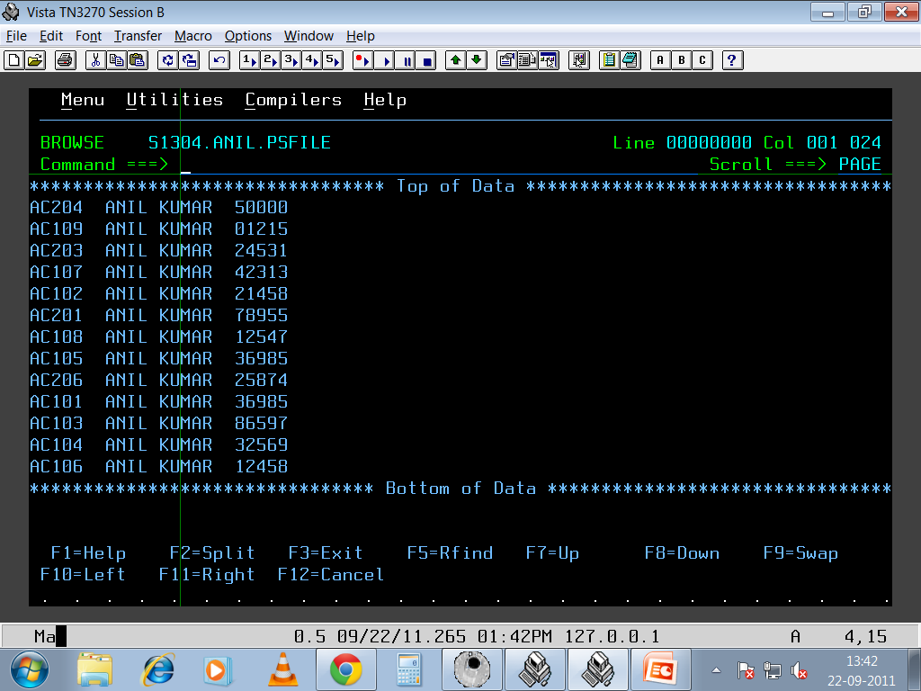
Notes:
UNSORTED INPUT FILE (FLAT FILE)

Slide 18
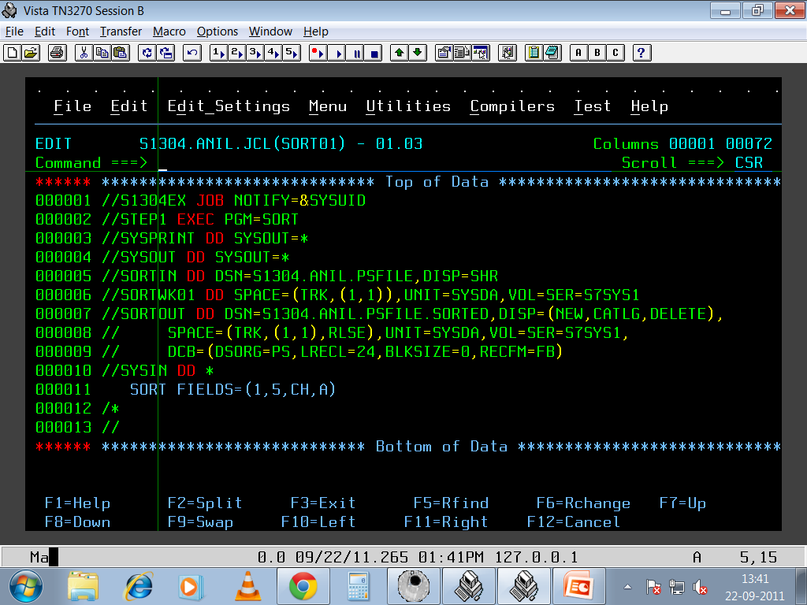
Notes:
SORT: SORT THE INPUT FILE

Slide 19
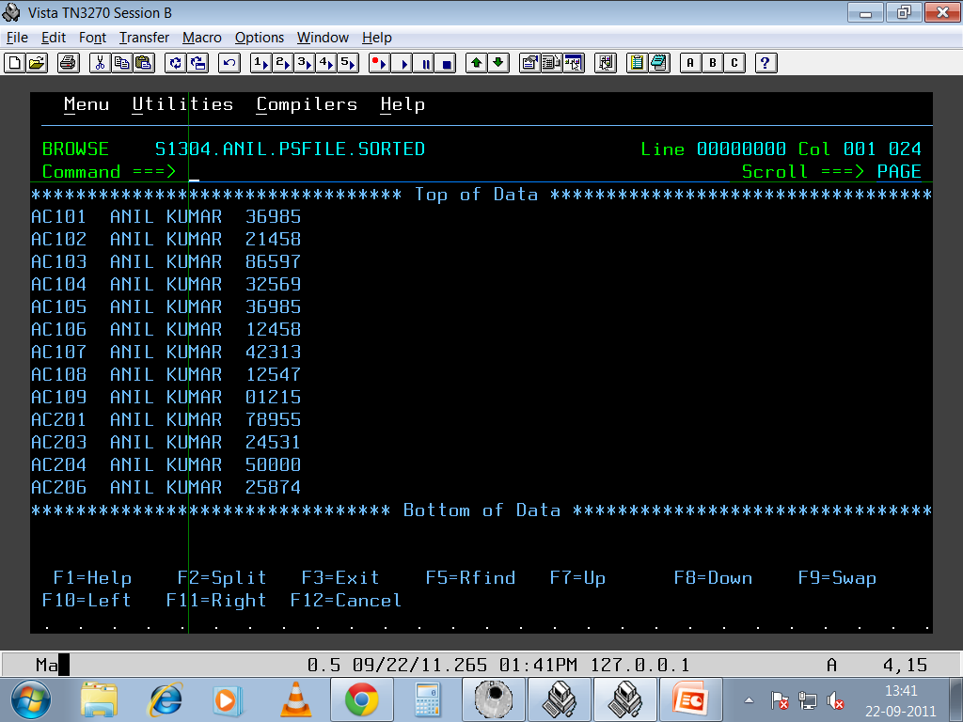
Notes:
SORT : RESULT

Slide 20
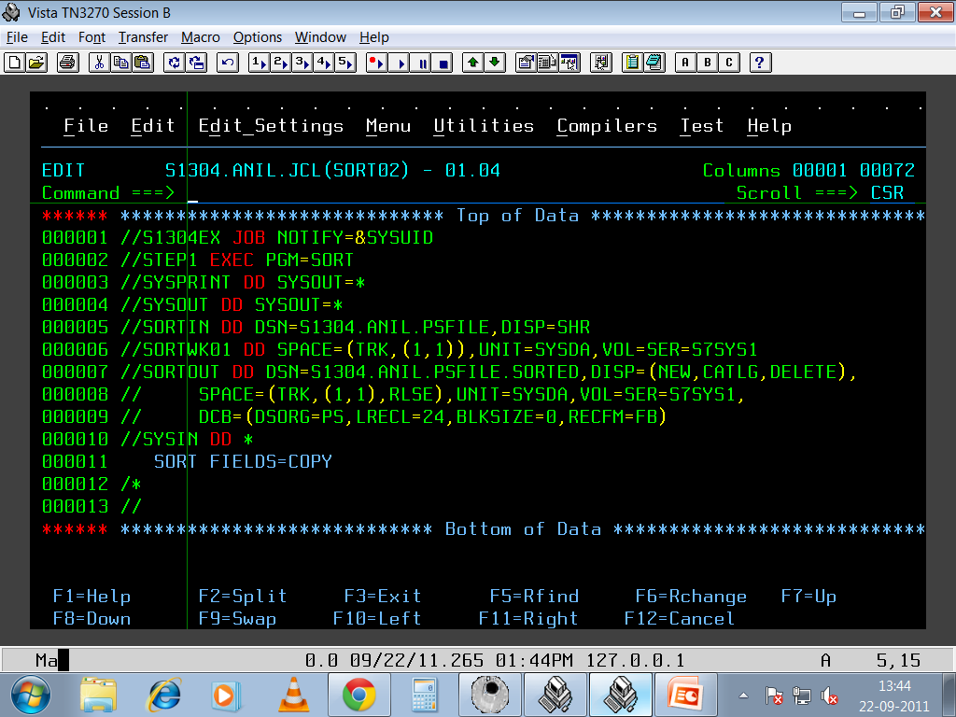
Notes:
SORT: COPYING INPUT FILE

Slide 21

Notes:
SORT : RESULT

Slide 22
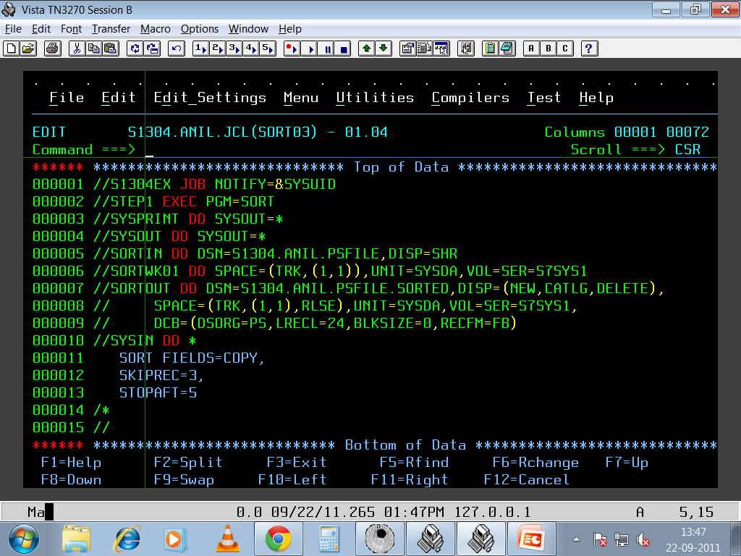
Notes:
SORT: Copy With SKIPREC And STOPAFT

Slide 23
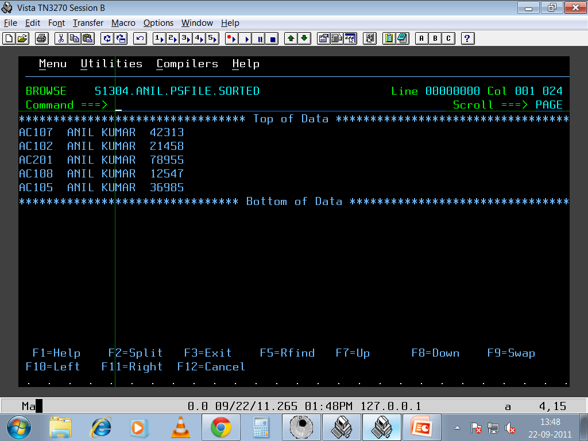
Notes:
SORT: Copy result

Slide 24
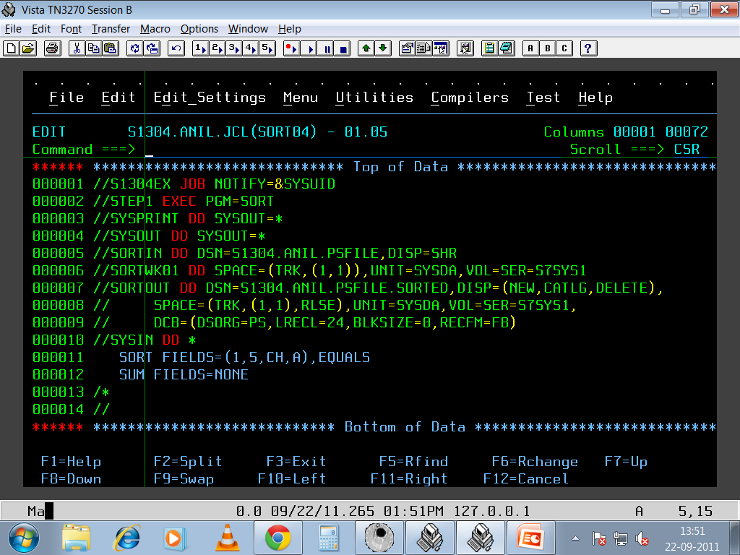
Notes:
SORT : ELIMINATE DUPLICATES

Slide 25

Notes:
SORT: INPUT FILE

Slide 26
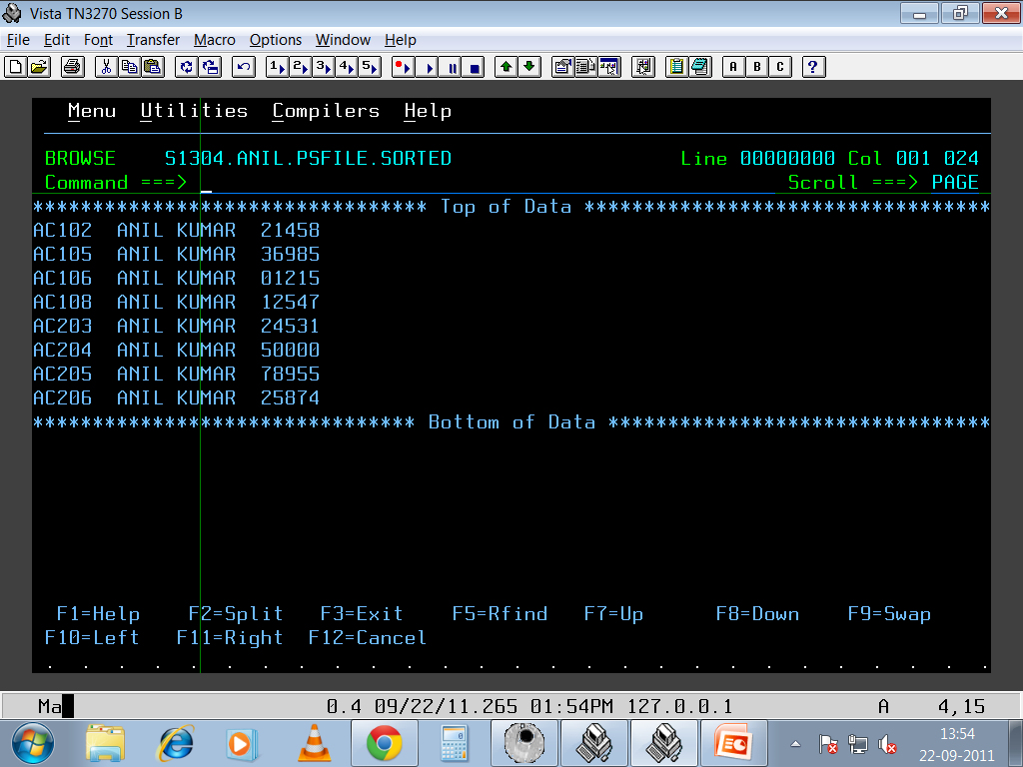
Notes:
SORT: RESULT

Slide 27
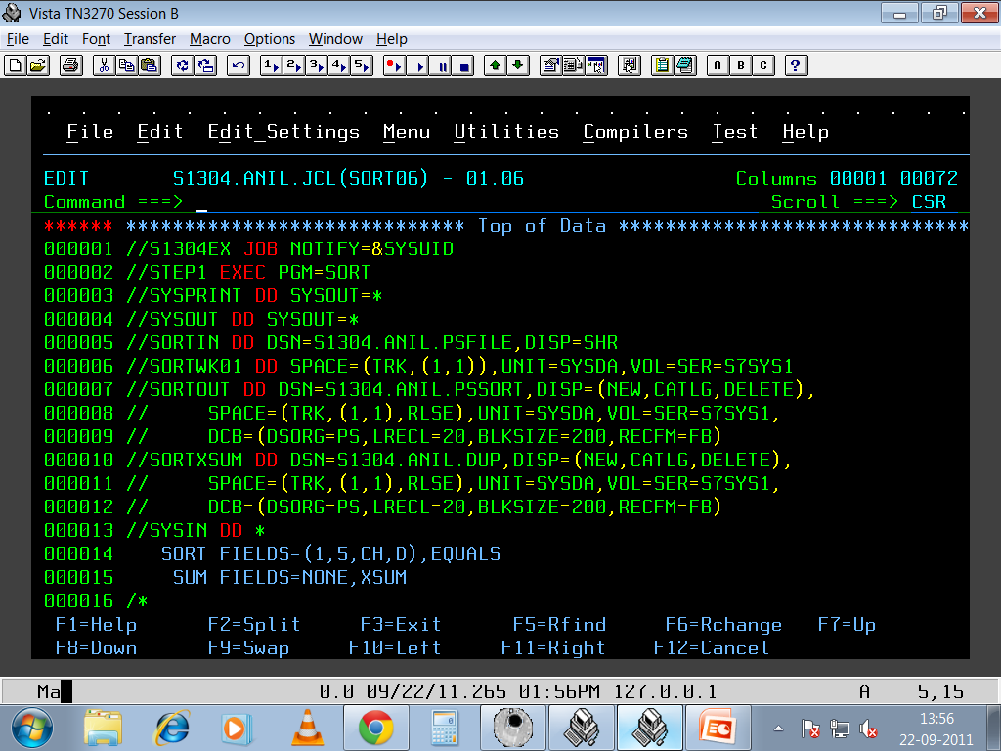
Notes:
SORT: XSUM

Slide 28

Notes:
SORT: INCLUDE COND

Slide 29
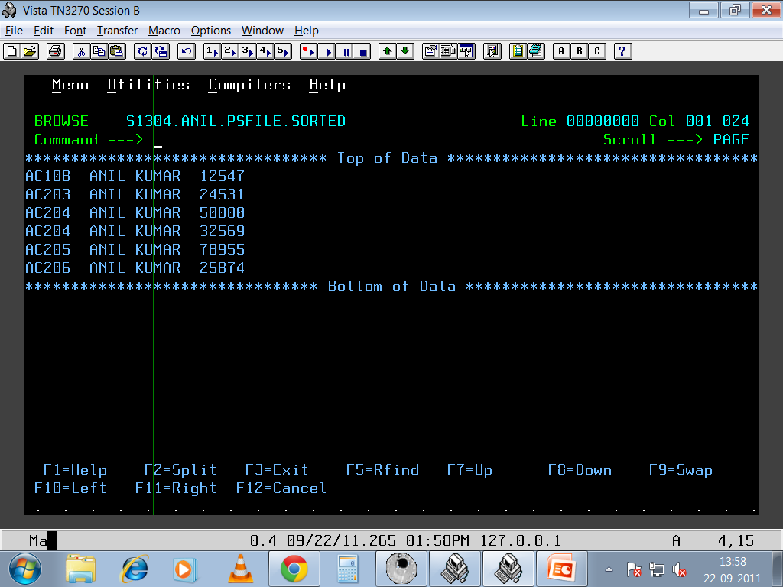
Notes:
SORT: RESULT

Slide 30

Notes:
SORT: OMIT COND

Slide 31

Notes:
SORT: RESULT

Slide 32

Notes:
SORT: INREC

Slide 33

Notes:
SORT: RESULT

Slide 34
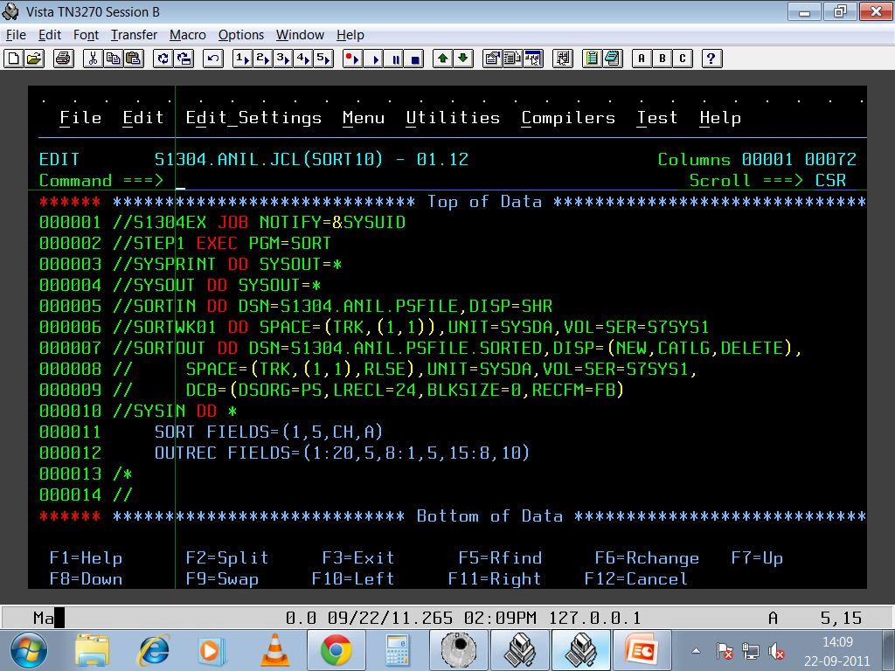
Notes:
SORT: OUTREC

Slide 35

Notes:
SORT: RESULT

Slide 36
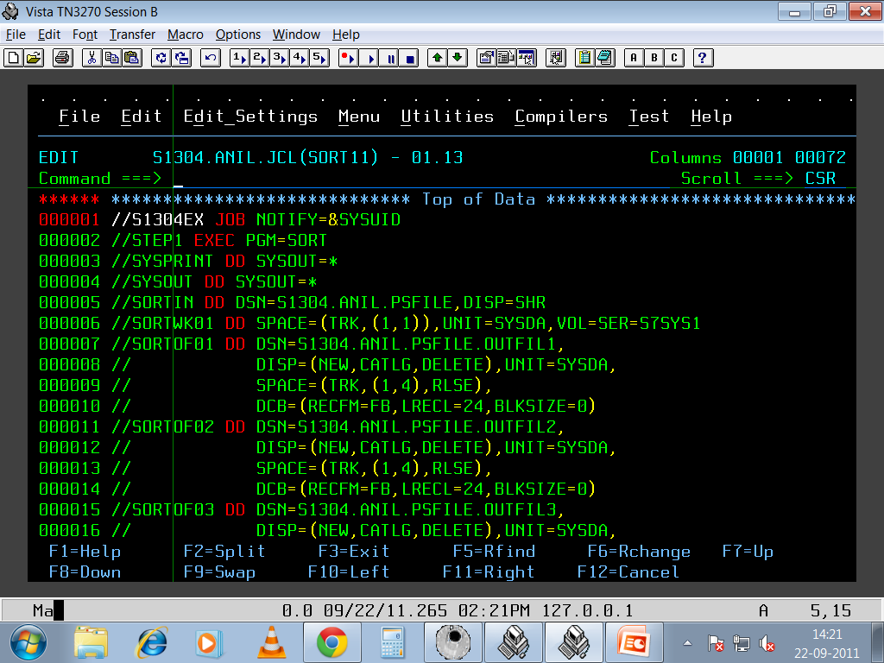
Notes:
SORT: OUTFILE

Slide 37
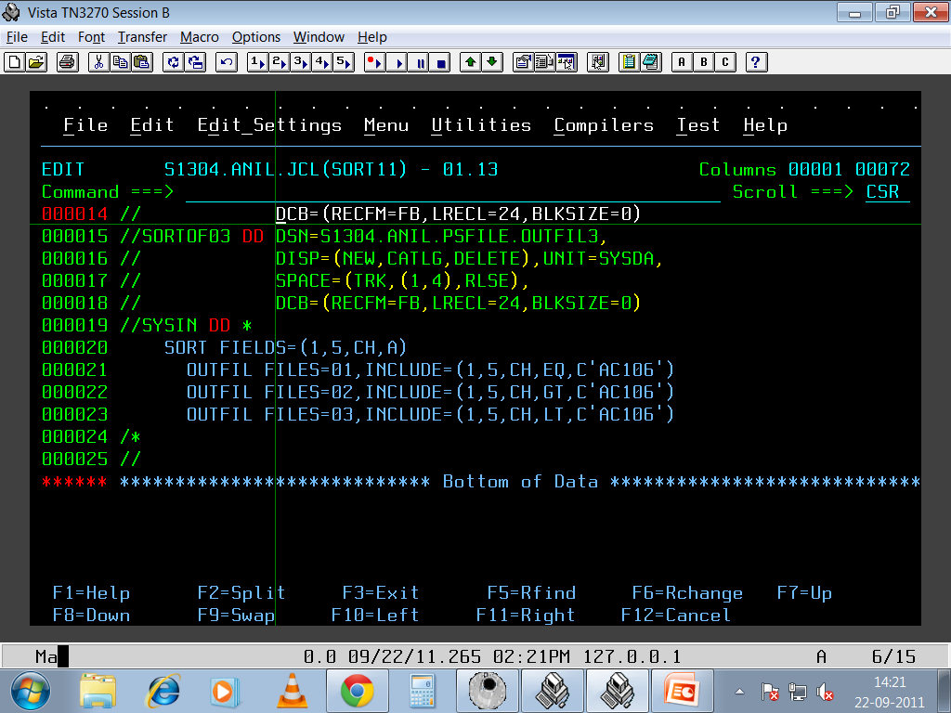
Notes:
SORT: OUTFILE CONT…

Slide 38
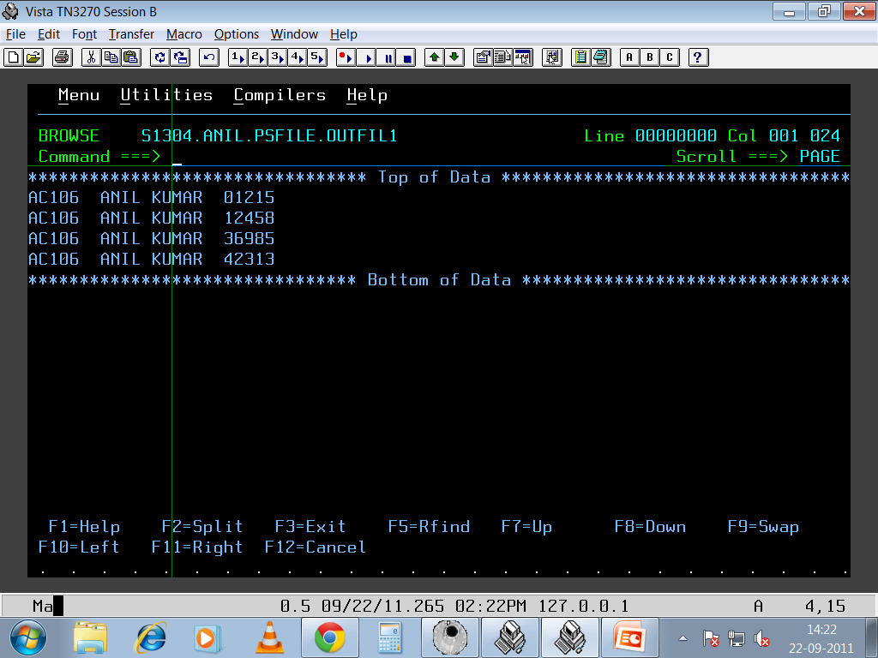
Notes:
SORT: RESULT1

Slide 39
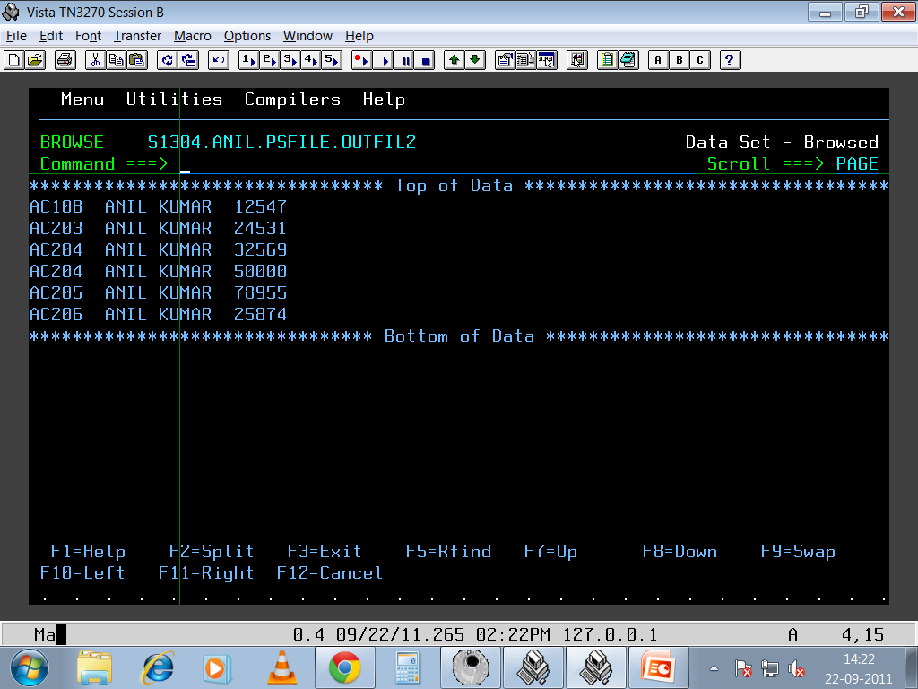
Notes:
SORT: RESULT2

Slide 40
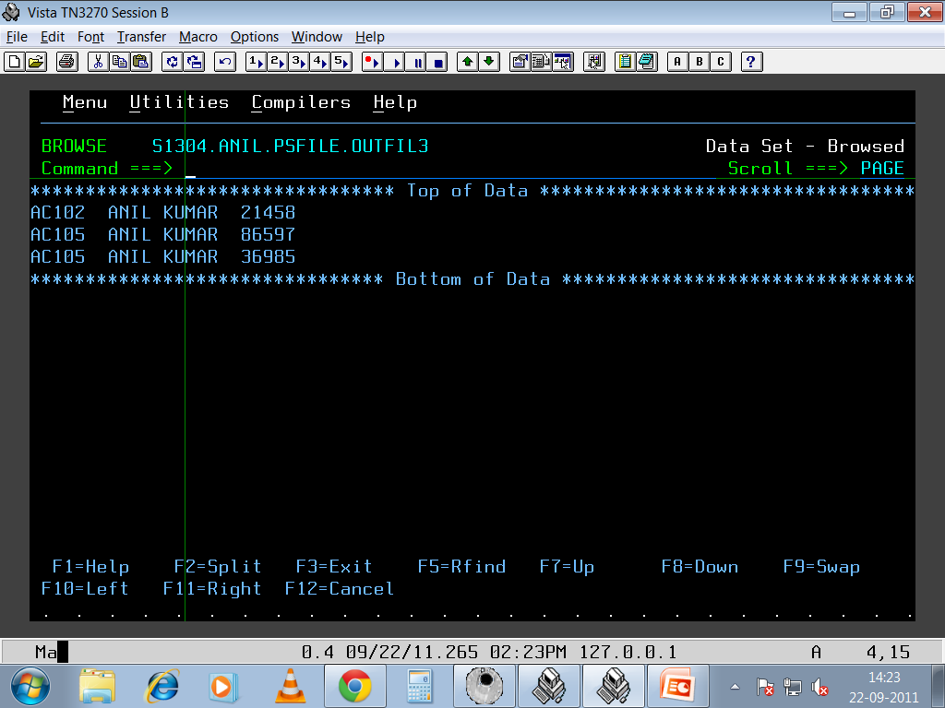
Notes:
SORT: RESULT3

Slide 41
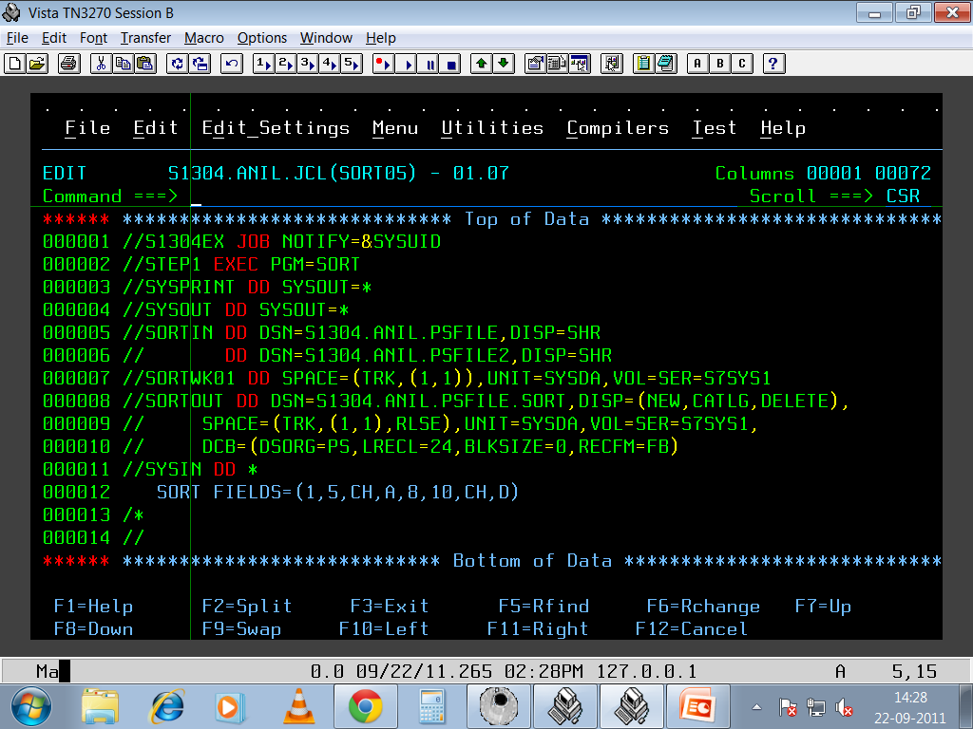
Notes:
Sort: Concatenation

Slide 42
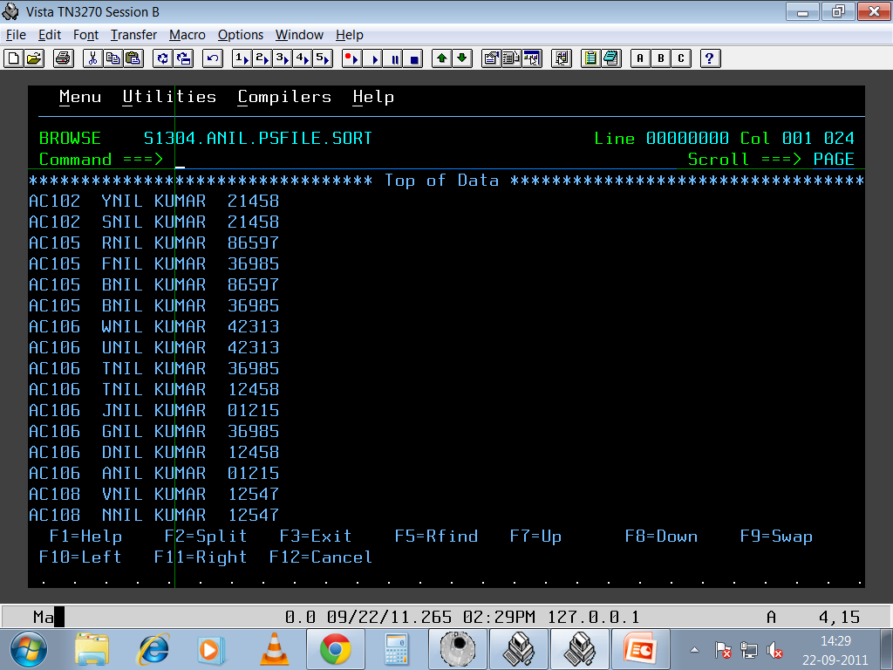
Notes:
SORT : RESULT

Slide 43
THANK YOU

